Slide 1
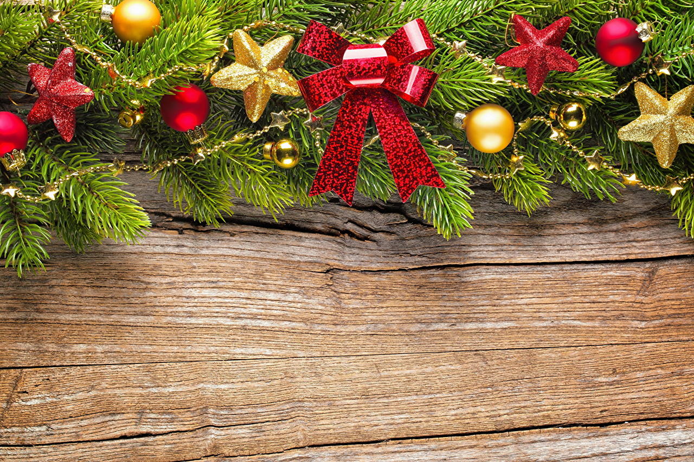


Christmas superstitions

Slide 2
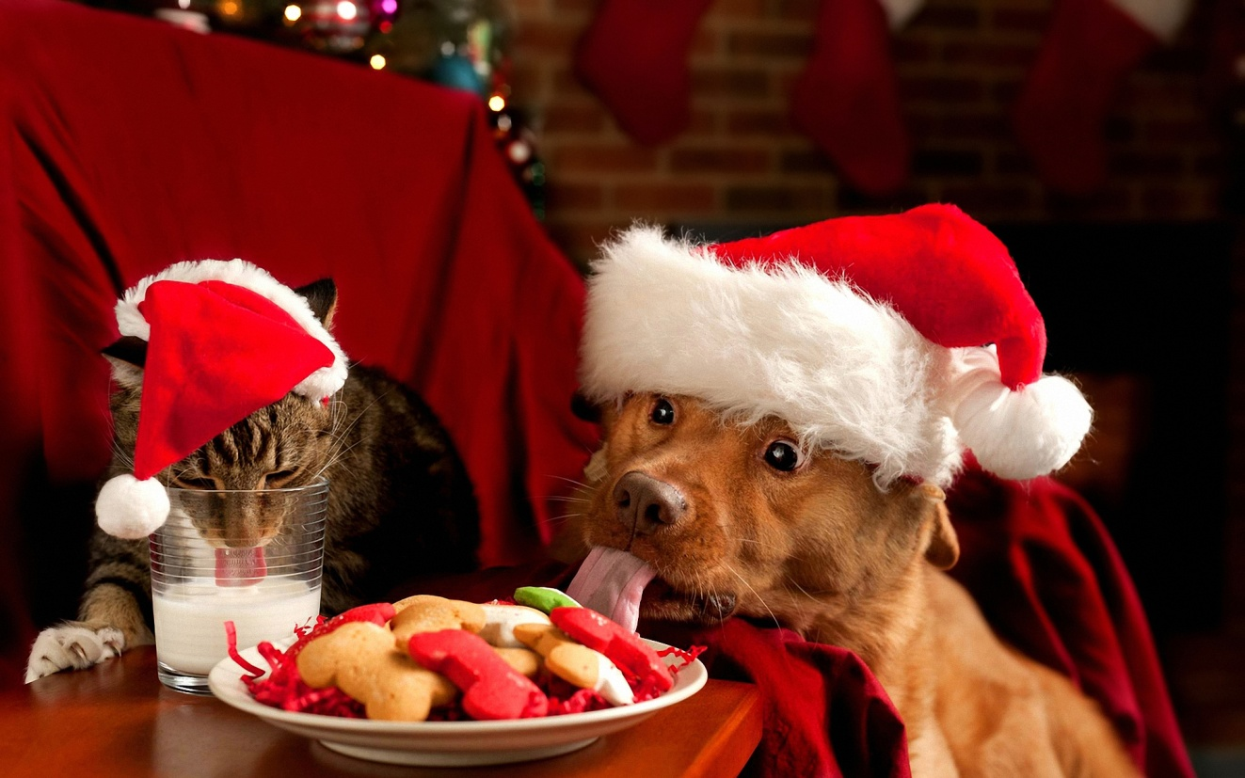
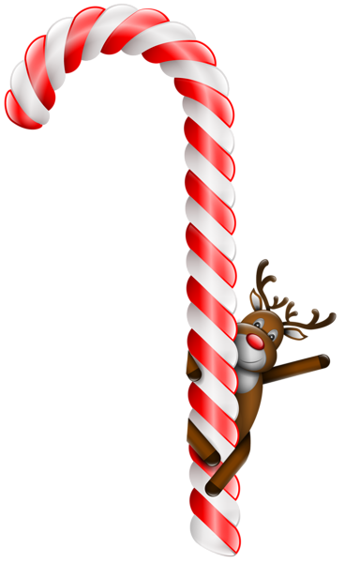
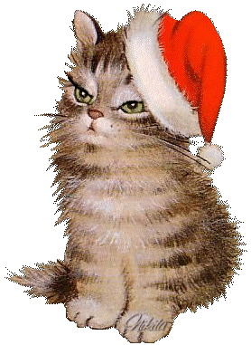
All pets are fed after dinner with the spirit to leave no living thing hungry on Christmas Eve

Slide 3


Christmas candles should be left burning until Christmas morning and should rest undisturbed from the time of lightning until they are sniffed

Slide 4


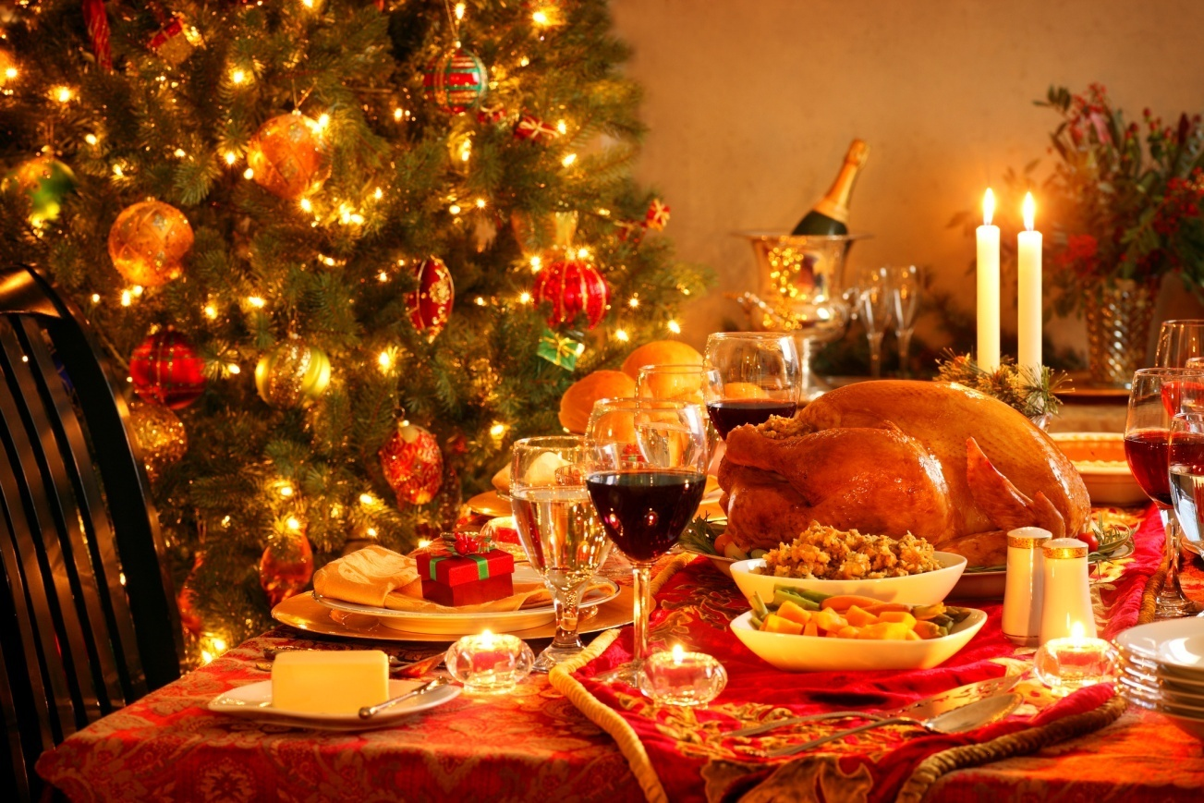

Christmas dinner consists of nine dishes

Slide 5
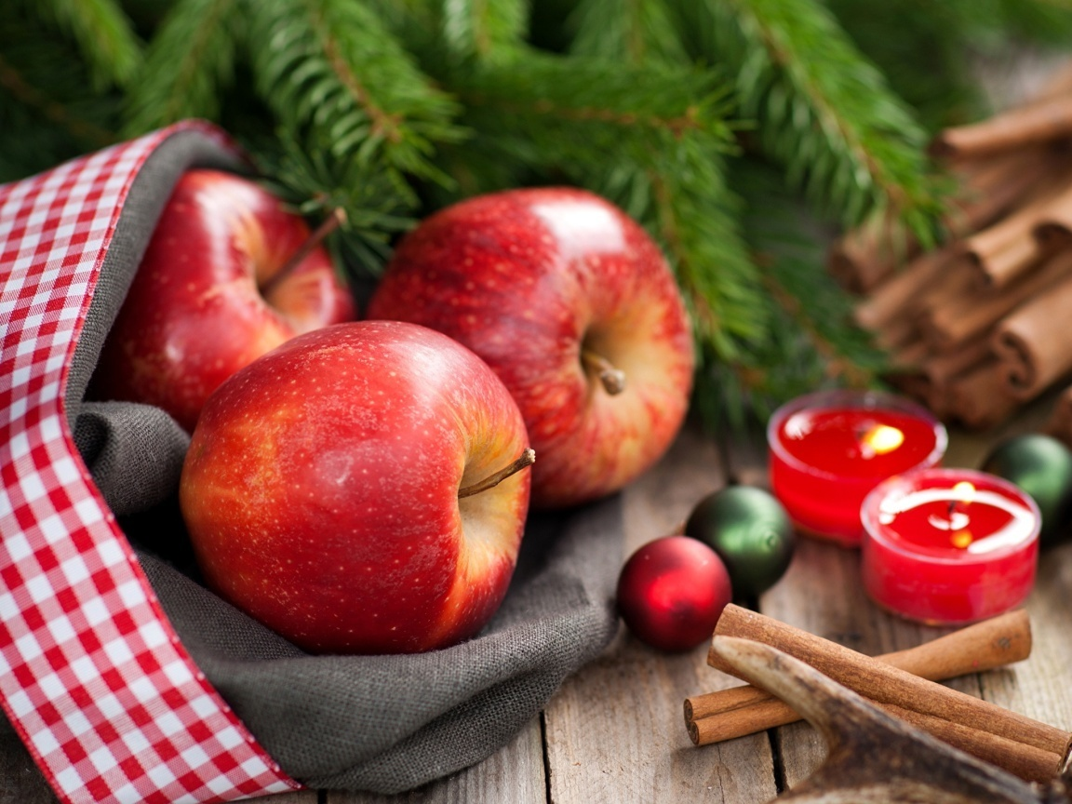
Everybody is given an apple after dinner, which is then cut in half lengthwise. If the core is star-shaped, the company is sure of meeting again safely next year. If anybody’s core is in a different shape, his death is predicted within twelve months time. The appearance of four-point cross is particularly a bad omen.

Slide 6
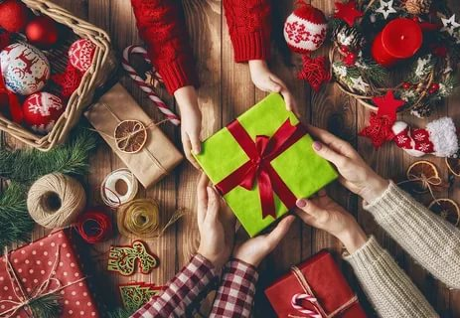
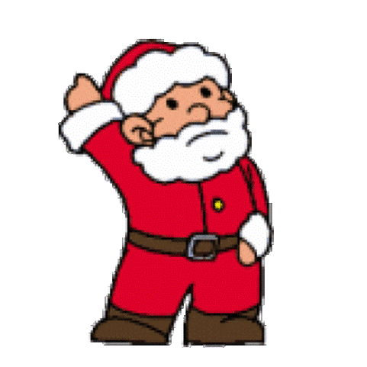
Give a present on Christmas eve, prosperity will not leave you

Slide 7
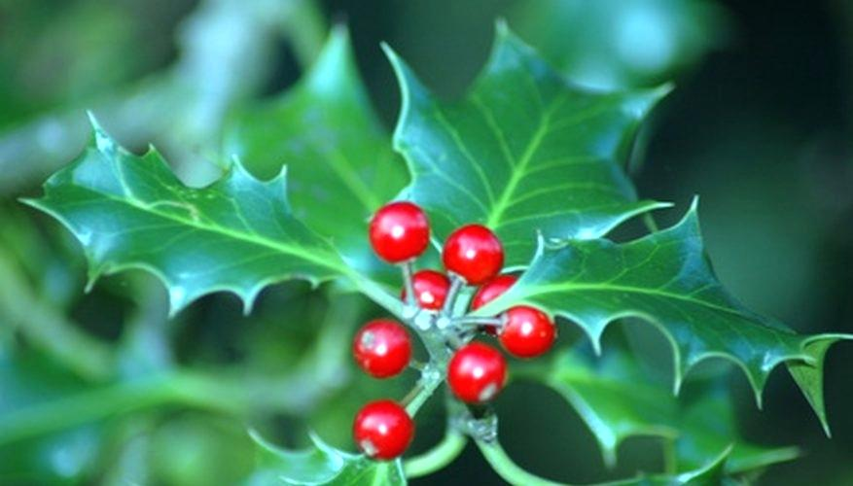
Good luck followed those who found a holly bush loaded with berries while removing Christmas greenery

Slide 8

It’s unlucky to do unnecessary work on Christmas day

Slide 9
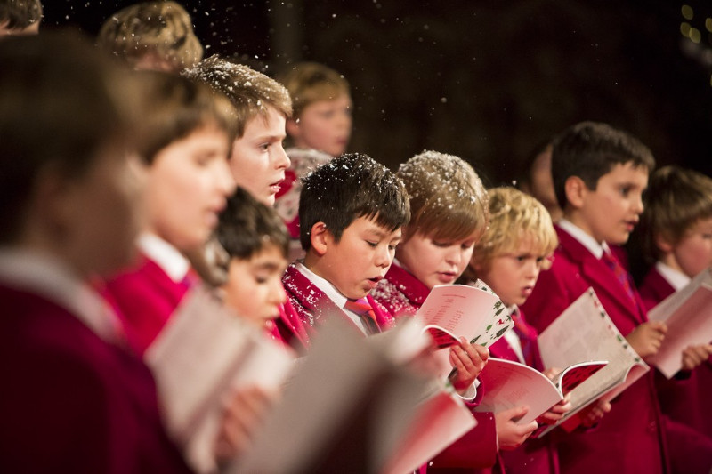
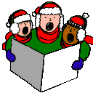
It’s unlucky to sing Christmas carols at any time other than during the festive season

Slide 10
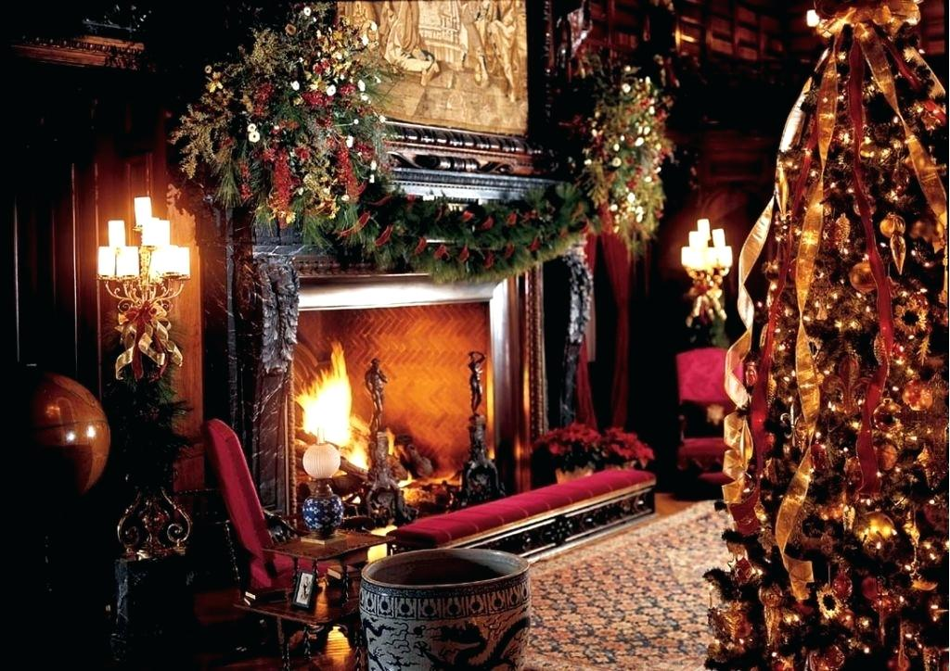

Look at the shadows cast by those gathered round the fire on Christmas night and if any of these shades appears to lack a head that person will die within the year

Slide 11

Never give shoes for Christmas gifts

Slide 12
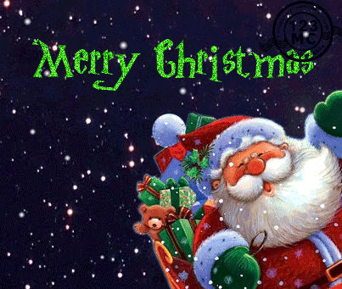

Ь
https://en.wikipedia.org/wiki/Christmas_traditions

